Slide 1

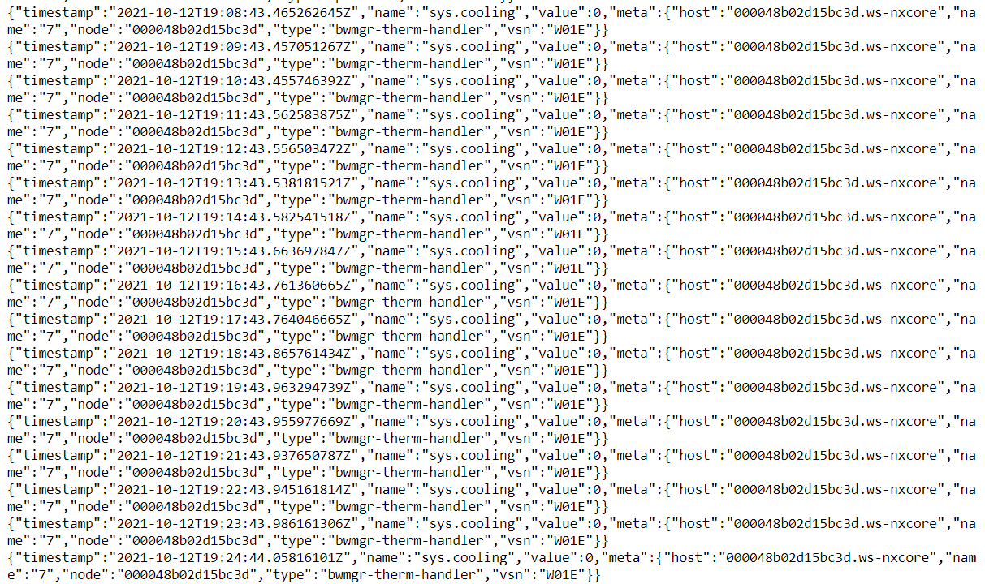
Findings from parsing data using python and curl
Heads up: Unfortunately, I could not view the data that was collected for about an hour in the json file. These are my findings for the data that was published for about 20 minutes. Whenever I tried to view the data for an hour, I would not get any output from the Jupyter notebook

Slide 2
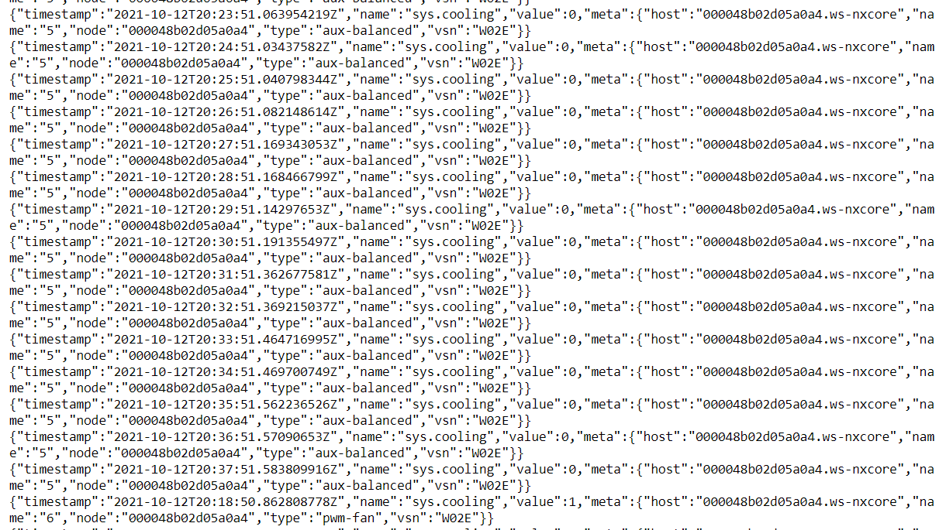
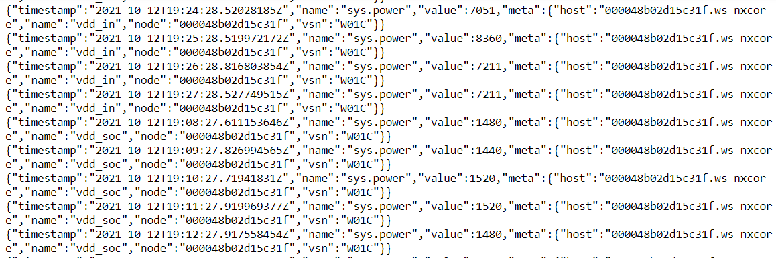
Big drop in power at 7:08 PM, according to the data
Sometimes the cooling value goes above 0

Slide 3
Questions, based on looking through the system metrics
What is the difference between sys.freq.ape and sys.freq.cpu?
What could cause a shift in power for some of the sensors? (As seen in the screenshot from the previous slide?
What does it mean when the sys.cooling value is 0 and what happens when it is above 0?
This metric confused me: “sys.freq.emc.” What does emc mean and is it any significant?

